Slide 1

http://blog.naver.com/shajung1999
기업의 주식과 선호도 사이의 관계

Slide 2



http://blog.naver.com/shajung1999
Presentation Title
?
Presentation Title
A presentation is the process of presenting a topic to an audience.

Slide 3



http://blog.naver.com/shajung1999
Presentation Title
Presentation
Presentation
Presentation
A presentation is the process of presenting a topic to an audience.
A presentation is the process of presenting a topic to an audience.
A presentation is the process of presenting a topic to an audience.

Slide 4
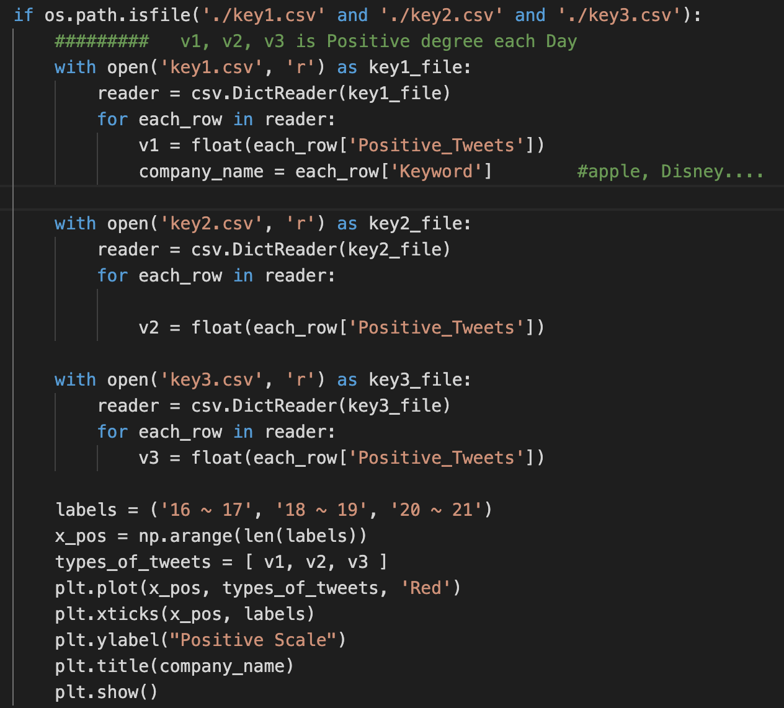
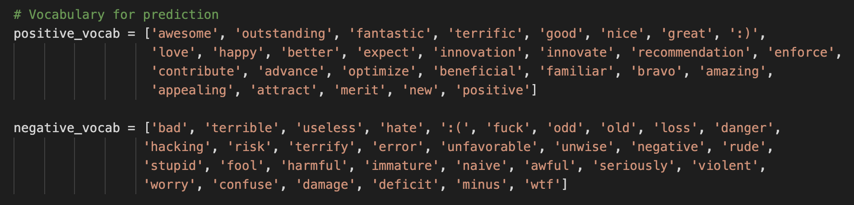
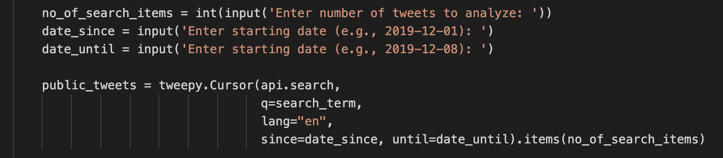
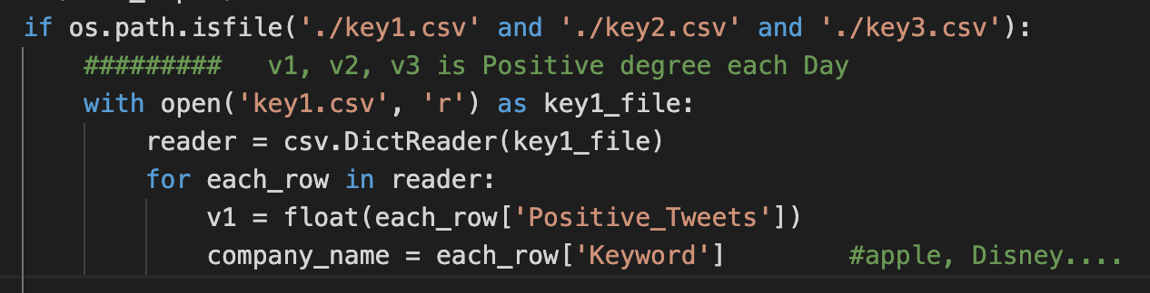
http://blog.naver.com/shajung1999
Presentation Title

Slide 5

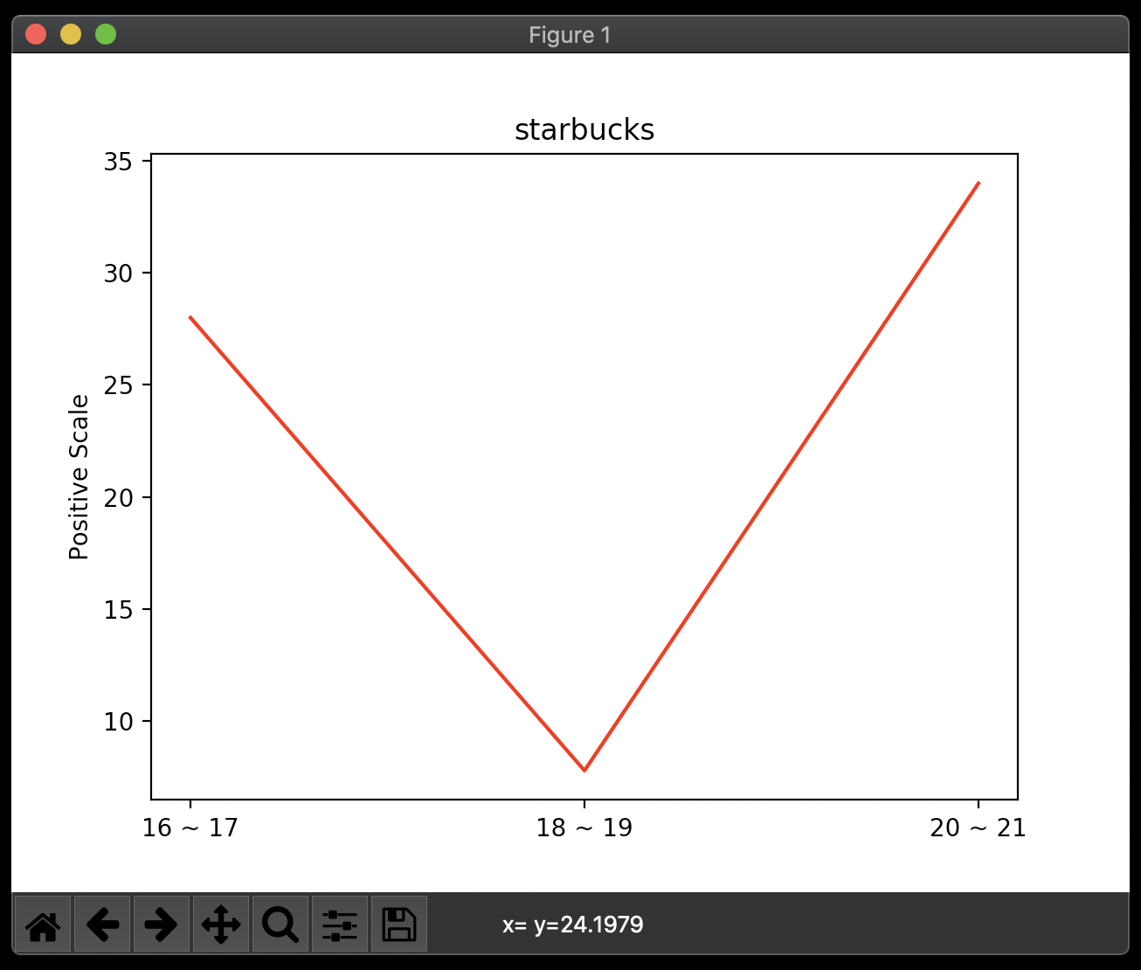
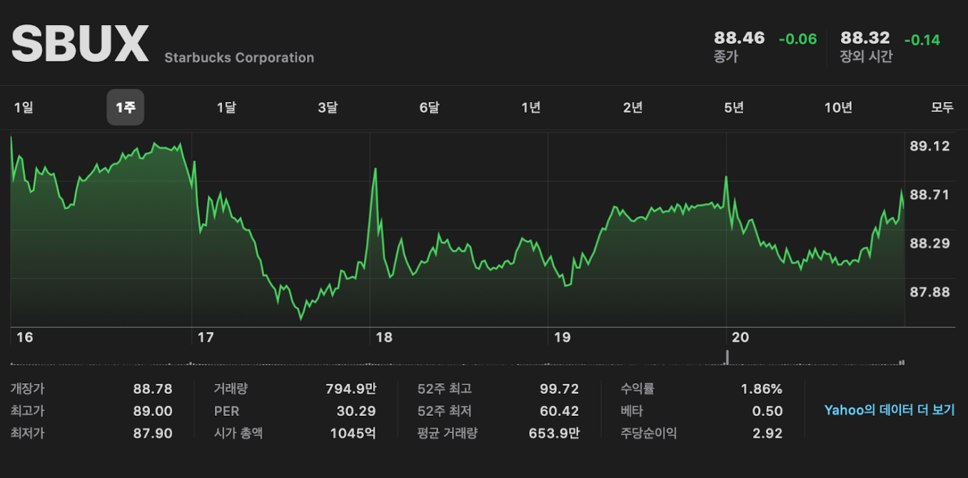
http://blog.naver.com/shajung1999
Presentation Title

Slide 6
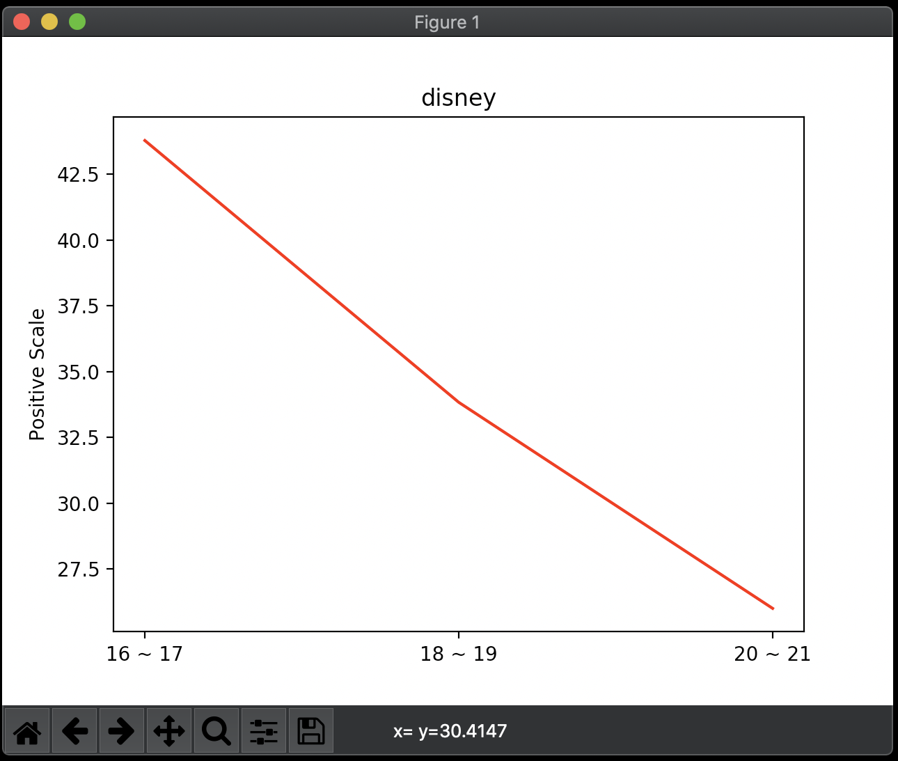
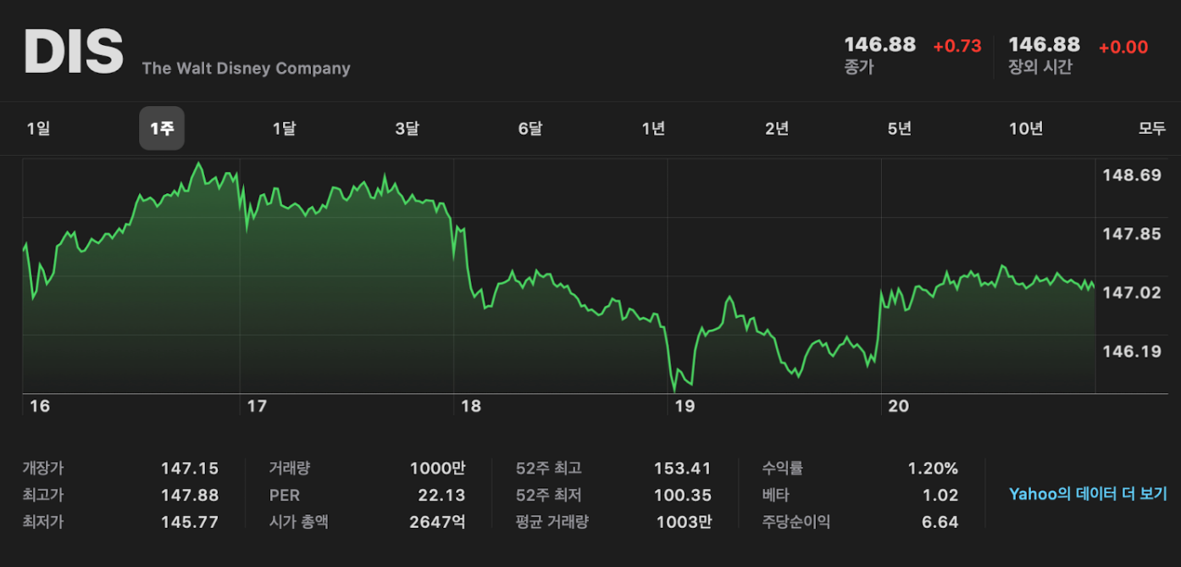
http://blog.naver.com/shajung1999
Presentation Title

Slide 7

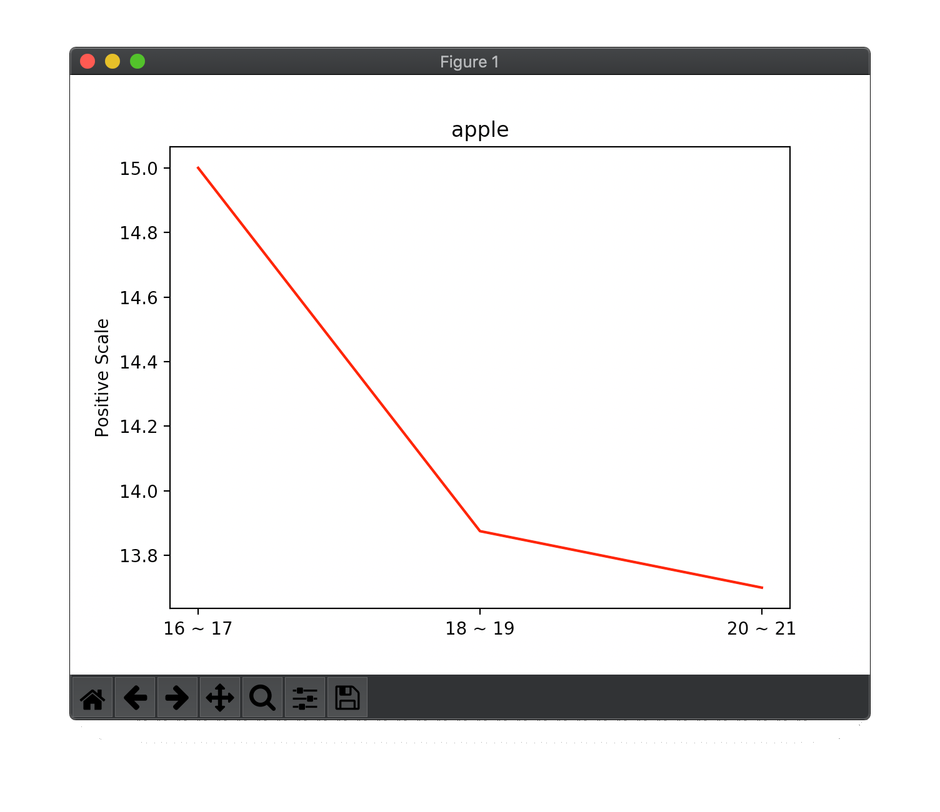
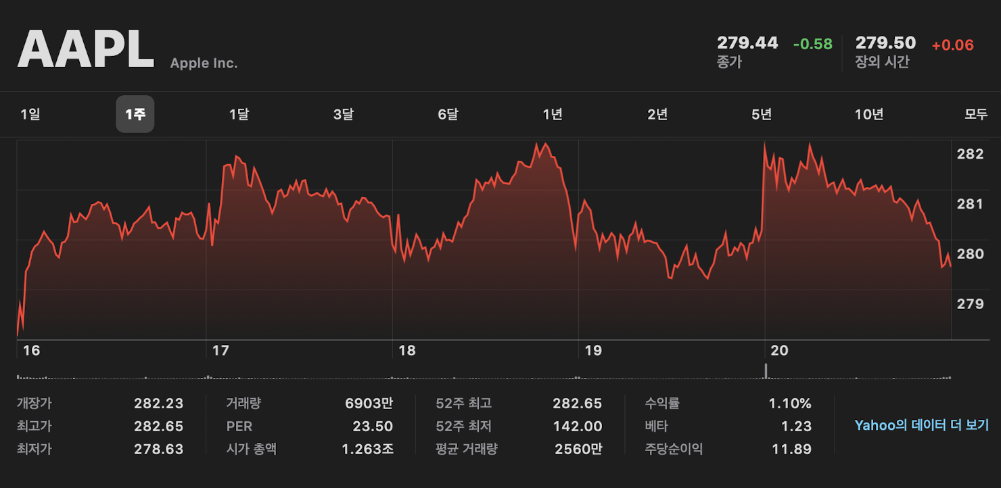
http://blog.naver.com/shajung1999
Presentation Title

Slide 8

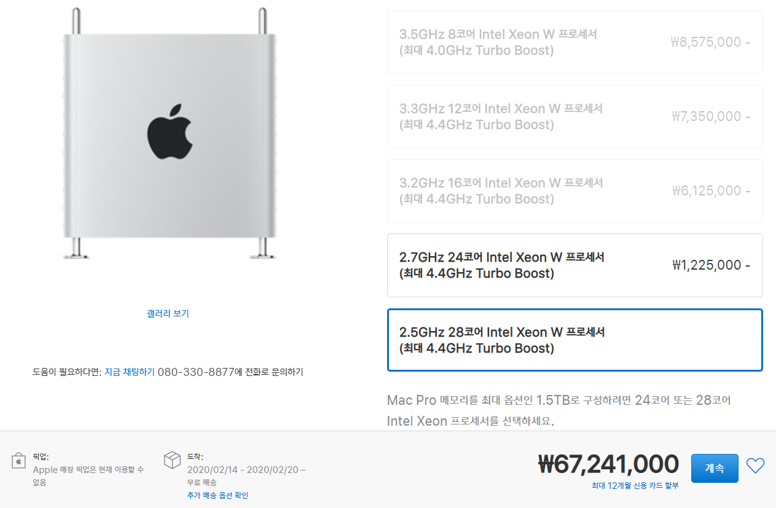




Slide 9
http://blog.naver.com/shajung1999
What is Presentation?
결론
Made by Hanarin

